Slide 1

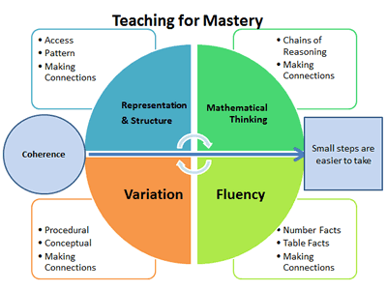

Paulerspury Primary School
Principles of a Mastery Lesson
Interactive Whole Class Teaching | All the children work on the same lesson content at the same time. This allows students to have mastered a concept before moving on to new content, making sure no one is left behind. Even as a mixed age school, when the objectives match, we teach the whole class together. The children will access the same activities and they will be differentiated accordingly. Where objectives do not explicitly match, the year groups will be separated by teacher and TA until that concept is learnt before coming together again for the next objective.
Differentiation | Activities can be differentiated through adult support, the resources provided, the method the child chooses to use or the output of an explanation. Where appropriate, children should be allowed to select the resources and method that they feel most confident using. All of these are used to assess a child’s understanding and address misconceptions immediately.
Small steps teaching | Each lesson is carefully sequenced to make sure all children are able to grasp new and potentially difficult concepts in small steps. This may mean filling gaps and addressing previous content before moving on to the new.
Conceptual Understanding | Teachers will provide the same concept or problem using a range of methods and representations to make sure that children have really mastered their understanding. Where they may not have understood it in one way, they may in another. Children in every year group should be taught each new concept using concrete, pictorial and abstract to aid understanding.
Intelligent Practice | Children are set questions or problems that have something in common, a pattern or a generalisation to help children develop their procedural fluency and conceptual understanding.
Full Sentences | Children are encouraged to use full sentences when answering the teacher, using the correct mathematical vocabulary at every stage in the school. As teachers, we scaffold this with the use of STEM sentences.
Early Intervention | Where the child has not grasped a concept, there should be same day (or as soon as possible) intervention to make sure that the child has fully grasped it before moving on.
Vision and Aims
We will:
Be confident and enthusiastic learners, who love learning Maths.
Master skills, making sure we have a deep understanding of concepts.
Develop a sound understanding of fluency, which will help us to reason and problem solve.
Develop reasoning so we can explain using precise mathematical terminology.
Apply our skills, using problem solving, for real-life and cross-curricular situations.
All value Mathematics and understand it’s importance in our everyday lives.
Principles of Learning
‘Every child can achieve’ ethos
We believe that every child has the potential to achieve expected and beyond.
Deep Learning
Children are required to demonstrate deep understanding through exploring sophisticated problems, explaining misconceptions and explaining, using correct mathematical vocabulary, how they used a method.
Concrete, Pictorial, Abstract Approach
CPA allows the children to work through concepts at a level and understanding that is suited to them.
Planning
LTP plots the sequencing throughout the year.
Designed by the Maths Co-Ordinator to collate objectives from White Rose Hub and year group specific objectives.
MTP identifies sequences of concepts for each topic of work.
White Rose Hub Mixed Age Planning is used to help facilitate small steps, identify potential misconceptions and plan mathematical vocabulary.
Daily Lessons
Focuses on small step, making sure that knowledge is fully understood before moving on. A range of representations are introduced and used to further understanding.

